Slide 1
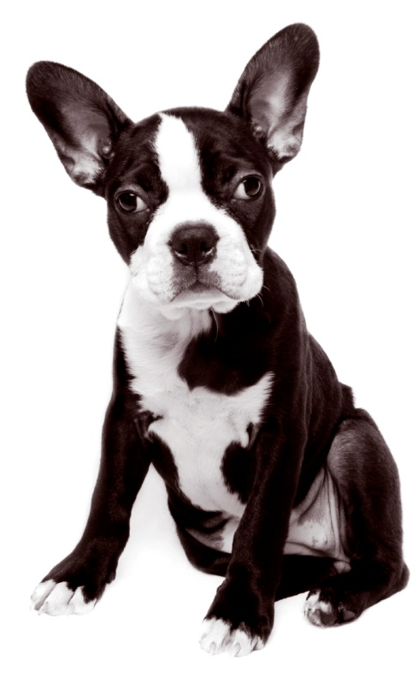
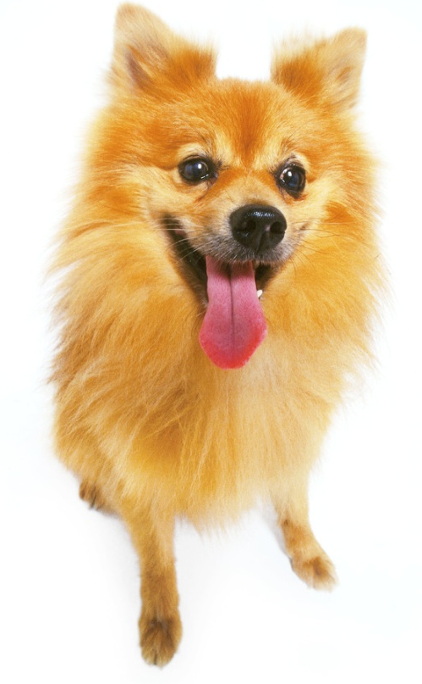
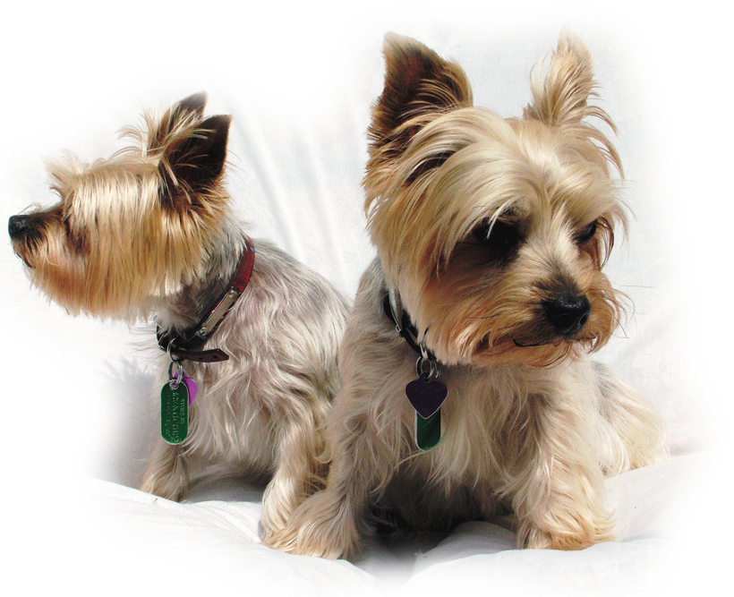
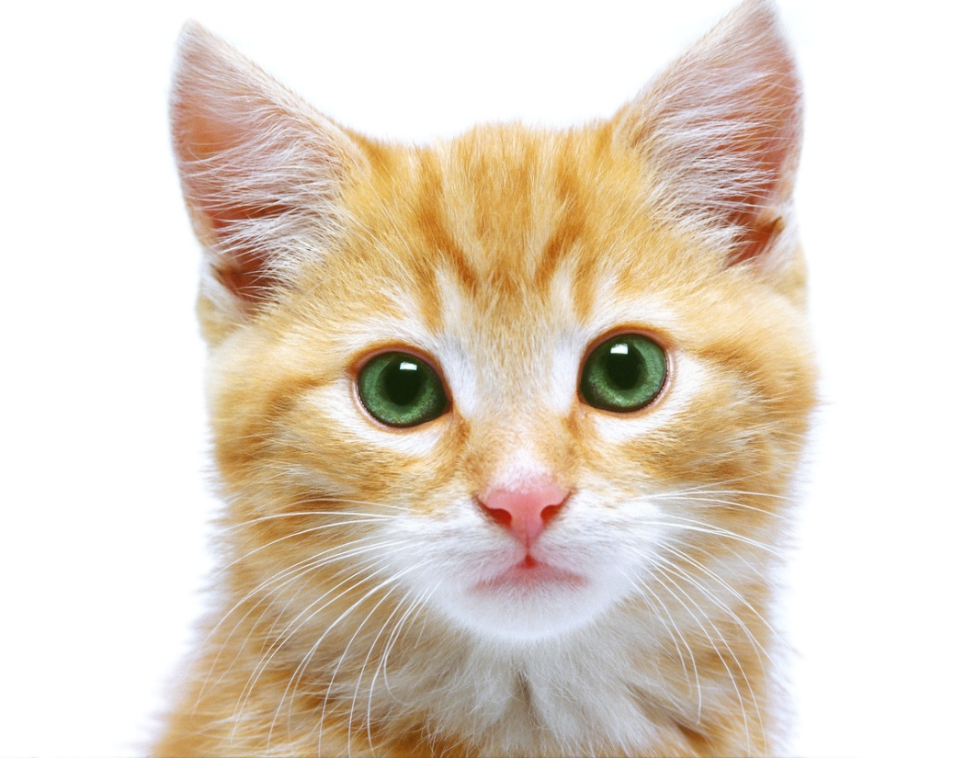
Ratios

Slide 2
You have just been hired at your local animal shelter. You will be in charge of providing care for all of the animals.

Slide 3
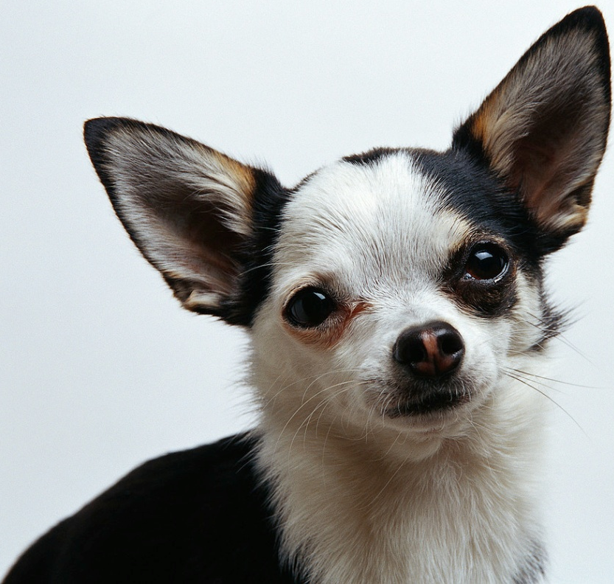
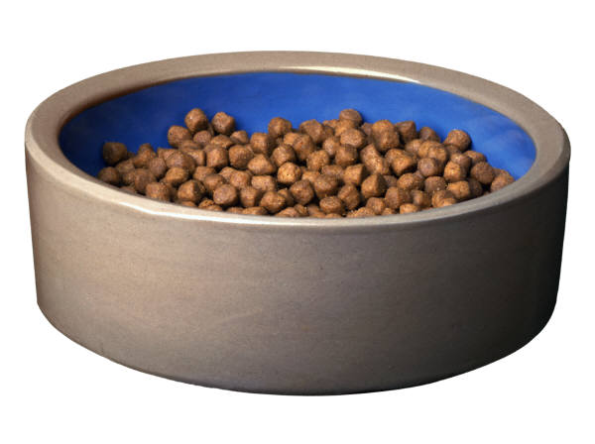
The job is a huge responsibility, but we know your intelligence and creativity are perfect for the job!

Slide 4
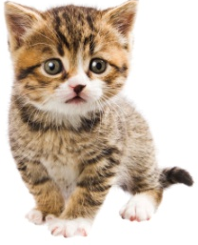
At the shelter, there are 4 puppies and 2 kittens.
You can compare the number of puppies and kittens using ratios.

Slide 5
A ratio is a comparison of two numbers using division.

Slide 6
There are three ways to write ratios.
 |  | Ways to Write a Ratio
Statement |  | In Words | With a Symbol | As a fraction
4 puppies to 2 kittens |  | 4 to 2 | 4:2 | 4 2

Slide 7
Write the ratio of kittens to puppies.
2 to 4
In Words
2:4
With a Symbol
2
4
As a fraction

Slide 8
You can also compare numbers to a total.
If there are 4 puppies and 2 kittens, what is the total number of baby animals?
6

Slide 9
What is the ratio of puppies to the total number of baby animals?
4 to 6
In Words
4:6
With a Symbol
4
6
As a fraction

Slide 10
What is the ratio of kittens to the total number of baby animals?
2 to 6
In Words
2:6
With a Symbol
2
6
As a fraction

Slide 11
Now complete the Practice Problems at your table.

Slide 12


The animal shelter has 5 dog biscuits and 7 squeaky toys. Write the ratio of dog biscuits to squeaky toys in three different ways.
5:7 5 to 7 $\frac{5}{7}$
There are 6 dogs with black spots and 9 dogs with brown spots. Write the ratio of dogs with brown spots to total dogs in three different ways.
9:15 9 to 15 $\frac{9}{15}$

Slide 13
Equal Ratios

Slide 14
Let’s arrange the 4 puppies and 2 kittens into groups. Each group has 2 puppies and 1 kitten.
The ratio of puppies to kittens in each group is 2 to 1.

Slide 15
The ratio of puppies to kittens in each group is 2 to 1.
The ratio of puppies to kittens in each group is 2 to 1.

Slide 16
4
The ratio of is equal to the ratio of .
These are equal ratios.
2
2
1

Slide 17
Equal ratios are ratios that have the same meaning. Both of these ratios show that there are twice as many puppies as there are kittens.

Slide 18
Let’s add another group of 2 puppies and 1 kitten.

Slide 19
6
How many total puppies are there?
3
How many total kittens are there?
What is the ratio of puppies to kittens?
6:3

Slide 20
,
, and are
6
4
2
3
2
1
equal ratios.
These ratios show that there are twice as many puppies as there are kittens.

Slide 21
Notice that
,
, and are
6
4
2
3
2
1
equivalent fractions. When written as fractions, equal ratios are equivalent fractions.

Slide 22

Let’s make a table. Add two puppies to the group for every one kitten added to the group.

Slide 23
Puppies | 2 | 4 | 6 | 8 | 10 | 12
Kittens | 1 | 2 | 3 | 4 | 5 | 6

Slide 24
12
6
4
2
and
are equal ratios.
We can find equal ratios by multiplying or dividing each term of the ratio by the same number!

Slide 25


÷3
=
÷3

Slide 26


x5
=
x5

Slide 27
Just like fractions, you can express ratios in simplest form. To write a ratio in simplest form, divide each term in the ratio by the Greatest Common Factor (GCF).

Slide 28
If there are 4 puppies and 2 kittens, what is the ratio of puppies to kittens in simplest form?
2:1

Slide 29
Now complete the Practice Problems at your table.

Slide 30
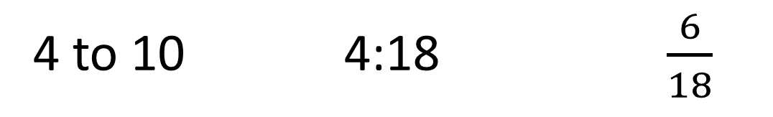
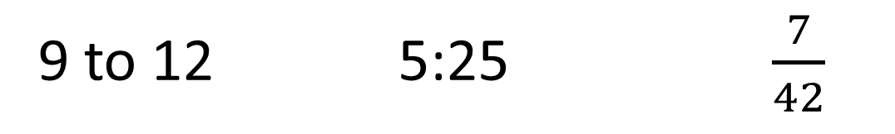
Write a ratio equal to each ratio.
4 to 10 4:18 $\frac{6}{18}$
2 to 5/8 to 20 2 to 9/8 to 36 $\frac{3}{9}$ or $\frac{1}{3}$ or $\frac{12}{36}$
Write each ratio in simplest form.
9 to 12 5:25 $\frac{7}{42}$
3 to 4 1:5 $\frac{1}{6}$

